Slide 1
BASH Strings
Scripting Essentials
Dr. Burkman

Slide 2
BASH Strings
Escaping double quotes
Just like we know. \”

Slide 3
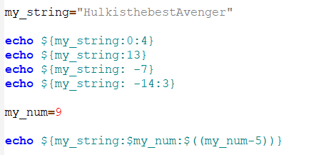

Slicing Strings

Slide 4

Cut starts with 1, not 0
Adding items to array my_array+=(“$cat “)
Use cut to slice up a string with -c, or use cut with -d to split a string on a delimiter. If you use –d also use –f to indicate the field or fields that you want.

Slide 5
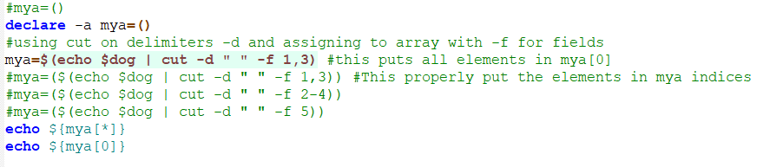
This makes $mya an array with everything at index 0. Declaring it an an array first will make no difference.
You *must* cut on a space to reliably create an array from a string

Slide 6
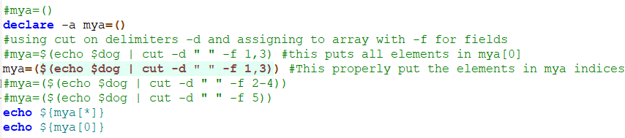
This makes $mya an array with elements in multiple indexes, regardless of whether you first initialize it or not.

Slide 7
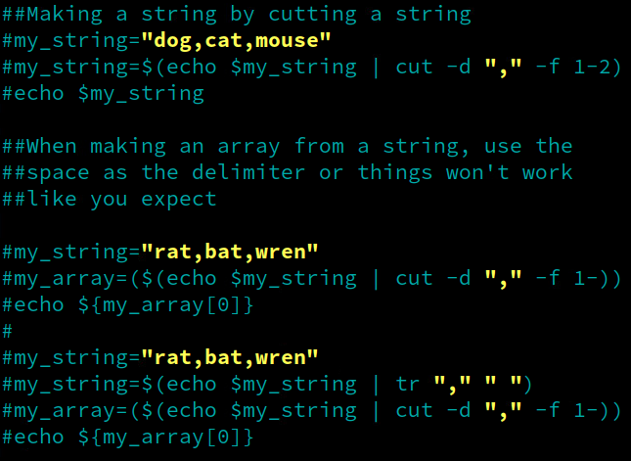
You can cut strings to make new strings, even with different delimiters
You can cut strings on delimiters to make new strings.
But when cutting a string to make an array be sure to only use the space “ “ delimiter. Otherwise your array won’t be correct.

Slide 8
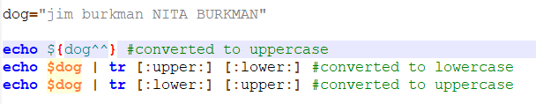
Converting case
Upper to lower and lower to upper is easy with tr. There is no mechanism for title case.

Slide 9
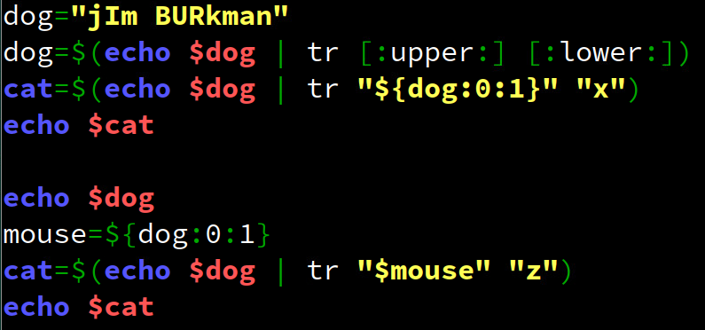
Converting case
Pay attention to the formatting if you transform with a variable:

Slide 10
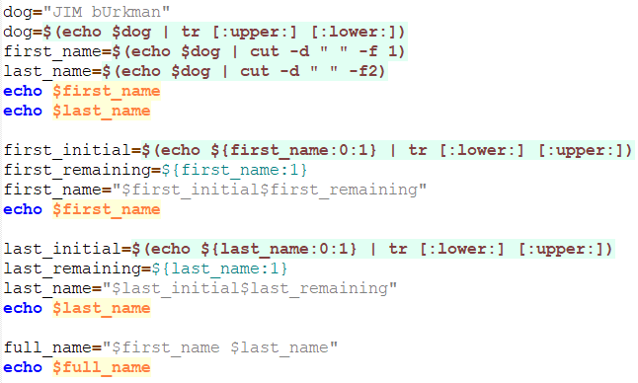
Title case a name

Slide 11
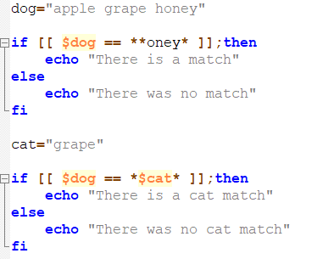
Matching a value to a string
There are no methods like we’ve had. So, this:

Slide 12
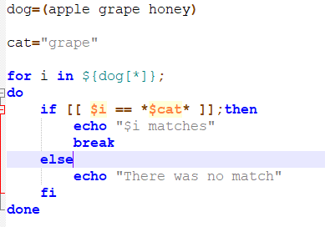
Matching a value to an array
If your elements don’t have spaces you can do this:

Slide 13
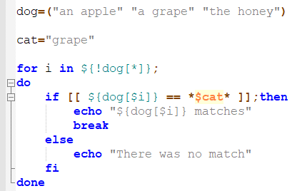
Matching a value to an array
If your element has spaces you must do this:
Note: Putting elements with spaces into an array is a huge hassle. Use _ instead of a space and just tr back and forth as needed for assigning variables and for printing

Slide 14
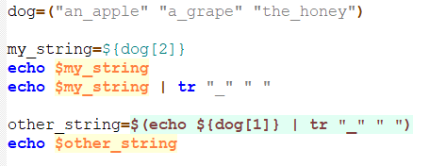
Array elements with spaces
Note: Putting elements with spaces into an array is a huge hassle. Use _ instead of a space and just tr back and forth as needed for assigning variables and for printing

Slide 15
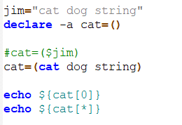
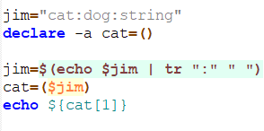
Add() around anything being added to array

Slide 16
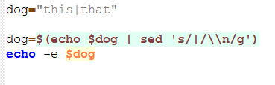
Sed for newlines
Echo –e interprets backslash escapes. If you want a new line in a string put \n in there, but you’ll have to use echo -e when printing to get it to work.
tr is byte substitution so it cannot substitute new lines (that’s two bytes). We have to use sed.
Breaking it down: sed ‘s/|/\\n/g’
s for substitute
/x/y/ replace x with y (\\n have to escape the backspace for sed)
g global - do this substitution everywhere in the line

